Slide 1
Towards Maximum Independent Sets on Massive Graphs
Juravle Andrei Iulian

Slide 2
Agenda
Maximum independent set
Problem statement
Related work
Greedy algorithm
One-K-Swap algorithm
Two-K-Swap algorithm
Experimental results
Conclusion

Slide 3
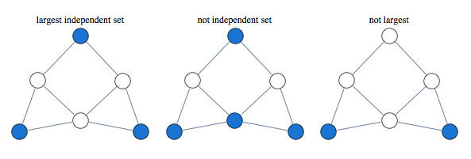
Maximum independent set
a fundamental problem in graph theory
has applications in:
social network analysis
graphical information systems
coding theory
NP-hard problem
Notes:
GIS = a system designed to capture, store, manipulate, analyze, manage, and present spatial or geographic data
Coding theory = the study of the properties of codes and their respective fitness for specific applications
NP = non-deterministic polynomial time

Slide 4
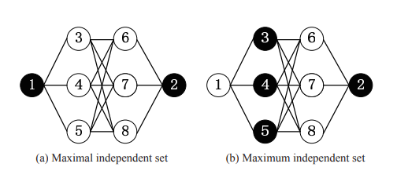
Maximum independent set
an independent set = a set of vertices in a graph, such that no two vertices in the set are connected by an edge
a maximal independent set = an independent set such that adding any other vertex to the set forces the set to contain an edge
maximum independent set = the largest maximal independent set

Slide 5
Problem Statement
Let G = (V, E) be a simple undirected graph with vertex set V and edge set E
Compute an independent set as large as possible for an undirected graph G(V, E) with limited memory M, c|V| ≤ M ≪ |G|
c = a small constant number (e.g., c = 2 or 3)
|V| = the number of vertices
|G| = the space for the entire graph G.

Slide 6
Related work
the existing methods require memory space at least linear in the size of the input graph (serious concern in view of the massive volume fast-growing graphs)
in-memory algorithms
external algorithms

Slide 7
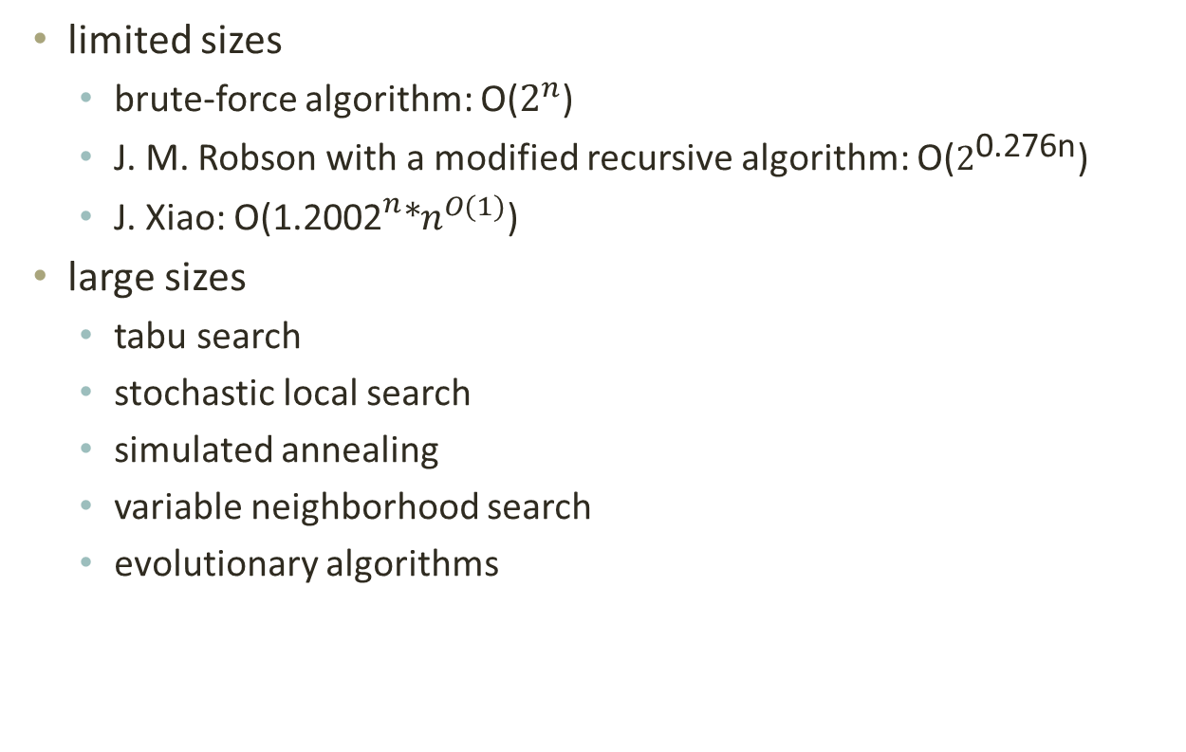
In-memory algorithms
limited sizes
brute-force algorithm: O($2^{n}$)
J. M. Robson with a modified recursive algorithm: O($2^{\text{0.276}\text{n}}$)
J. Xiao: O(${\text{1.2002}}^{n}\text{∗}n^{O(1)}$)
large sizes
tabu search
stochastic local search
simulated annealing
variable neighborhood search
evolutionary algorithms

Slide 8
Proposed algorithms
Greedy algorithm
One-K-Swap algorithm
Two-K-Swap algorithm

Slide 9
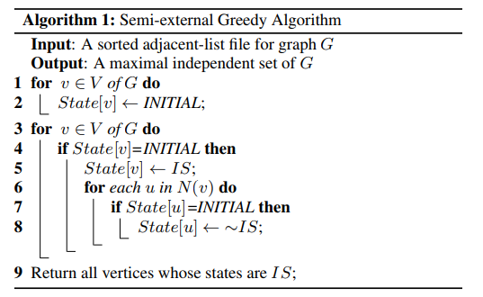
Greedy algorithm
Notes:
the high-level idea is to repeatedly add vertices with small degrees to the independent set IS if none of their neighbours is added to IS
given a sorted adjacent file by the ascending order of the degree of vertex
N(u) denotes the set of vertices adjacent to u

Slide 10


Greedy algorithm
semi-external greedy algorithm
needs a preprocessing phase to sort the vertices by degrees
scans the adjacent lists only once
the sort cost is:
B is the block size
M is the main memory size
the scan cost is:

Slide 11
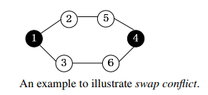
One-K-Swap algorithm
finds a larger independent set than the greedy algorithm
input: an adjacent-list file of graph G and an initial IS
output: a larger independent set of G
uses swap operations
0 ↔ 1: adds a new IS vertex
1 ↔ k: exchanges one IS vertex with k non-IS vertices
challenges:
costly random accesses
swap conflict
Notes:
to decide whether a swap operation can be performed correctly to guarantee an independent set
two swaps cannot be performed simultaneously
we need a mechanism to allow one and only one swap to be successfully performed

Slide 12
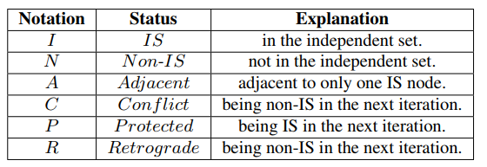
One-K-Swap algorithm
for each adjacent vertex v, we maintain a set ISN(v) to record its IS-Neighbour (only one)
Notes:
adjacent vertex is a non-IS vertex which is adjacent to only one IS vertex
protected vertex is an adjacent vertex, which can be swapped to an IS vertex in the next iteration
conflict vertex is also an adjacent vertex, but it cannot be swapped to an IS vertex in the next iteration
retrograde vertex is an IS vertex which will be swapped to a non-IS vertex in the next iteration

Slide 13
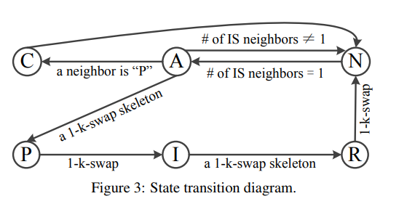
One-K-Swap algorithm
Algorithm
repeatedly scans the adjacent file in the disk and updates the states of vertices
finally, all vertices with states “I” are returned as an independent set
Notes:
first, the vertices that have only one IS neighbour have the potential to swap
three phases: pre-swap, swap and post-swap
pre-swap phase
(i) u has conflicted with other swap candidates
(ii) there is a new 1-2 swap skeleton for u
(iii) there will be a 0-1 swap for u
swap phase, more vertices are added to the independent set
post-swap phase, some 0-1 swaps are performed to guarantee that the returned result is a maximal set

Slide 14
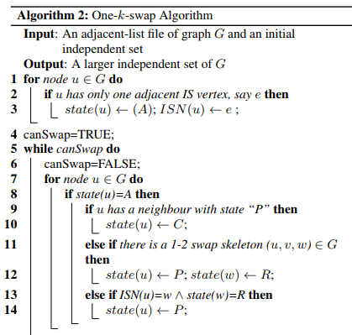
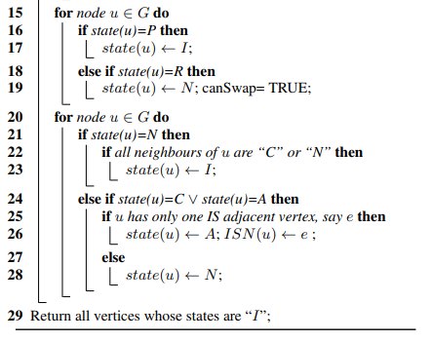
One-K-Swap algorithm
Notes:
first, the vertices that have only one IS neighbour have the potential to swap
three phases: pre-swap, swap and post-swap
pre-swap phase
(i) u has conflicted with other swap candidates
(ii) there is a new 1-2 swap skeleton for u
(iii) there will be a 0-1 swap for u
swap phase, more vertices are added to the independent set
post-swap phase, some 0-1 swaps are performed to guarantee that the returned result is a maximal set

Slide 15
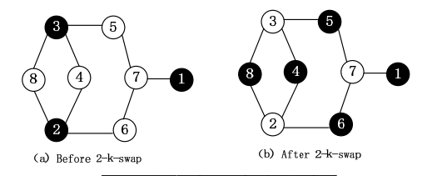
Two-K-Swap algorithm
extends the one-k-swap algorithm to support two-k swaps, which exchanges two IS vertices with three or more non-IS vertices
six states: {I, N, A, P, C, R}
state “A” is changed, where a non-IS vertex may be adjacent to one or two IS vertices (ISN set now may include two IS vertices)

Slide 16
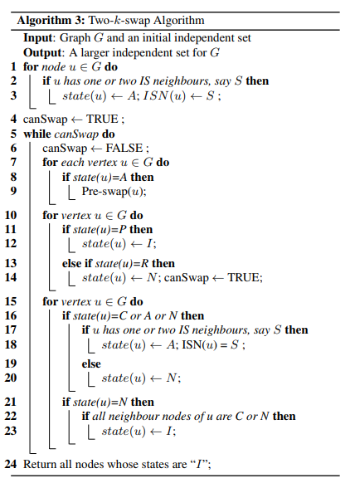
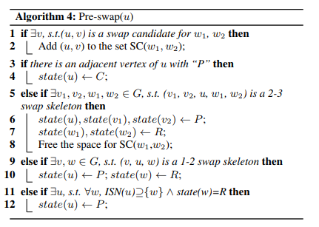
Two-K-Swap algorithm
Notes:
find the vertices with state “A” which are potential to swap
similar to the one-k-swap algorithm, there are three phases at each round: Pre-swap, Swap and Post-swap

Slide 17
Two-K-Swap algorithm
similar to the one-k-swap algorithm, two-k-swap can stop within limited number of iterations to guarantee the efficiency
I/O cost is O(scan(|V| + |E|))
memory cost for the state array and the ISN set is no more than 3|V|, as each ISN set contains at most two vertices
time cost is O(|V|log|V| + |E|).
Notes:
the most costly steps are Lines 1 and 5
line 1: the worst-case cost is degree(u)+degree(w1)+degree(w2), since for each v ∈ ISN(w1) or ISN(w2), we check if there is an edge between u and v
line 5: degree(u)+|SC(w1, w2)|. It is easy to see that |SC(w1, w2)| ≤ degree(w1)+degree(w2).

Slide 18
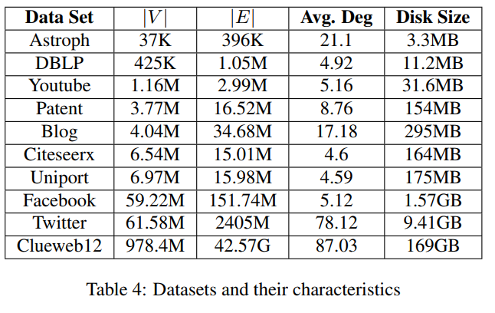
Experimental results
All the algorithms were implemented in C++ and the experiments were performed on a Core i5 CPU 4.0GHz running Windows 7 operating system with 8GB RAM and a 500GB hard disk.

Slide 19
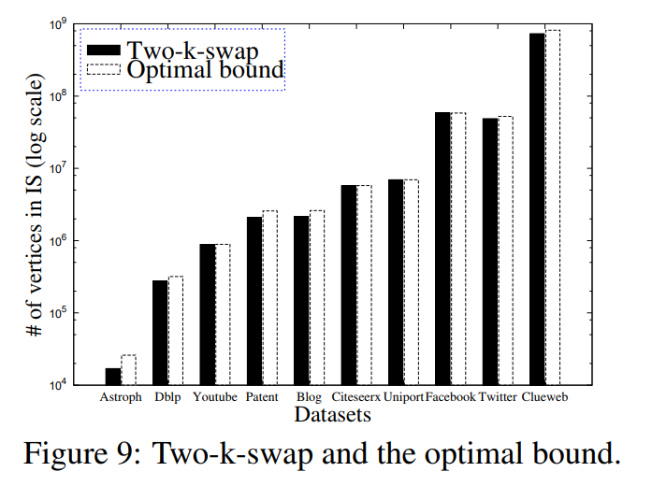
Experimental results

Slide 20
Conclusion
this work has studied the problem of the maximum independent set on massive graphs
solution starts with studying a delightfully simple yet effective greedy approach
two swap-based solutions, called ONE-K-SWAP and TWO-K-SWAP algorithms
our algorithm can compute an independent set which is closely to the theoretical optimal bound for massive real-life graphs using very limited main memory

